Slide 1
Claire Lewis - Visteon
May 24th 2017

Slide 2
UK CITE Project Overview
The project will be trialling
Mixed road types and speeds up to 70mph
Functionality, Safety and Convenience
Both DSRC 802.11p and LTE V
Wi-Fi services on the move
Road network efficiency and modelling
Multipath broadcasting using multiple communications methods
Whole journey experience - Interlink between the urban and Strategic Road Network
The Vehicle Manufacturers & Suppliers
Local and National Highways Authorities
Stakeholders
The consumer/ businesses and their journey experience
Communications Companies and Infrastructure Providers
Co Project Leads

Slide 3
Work Packages and Leads
WP1 – Project Management – Visteon
WP2 – Back Office – Siemens
WP3 – Infrastructure – Highways England
WP4 – Vehicle Systems – JLR
WP5 – Cyber Security – University of Warwick (WMG)
WP6 – Trialling and Testing – JLR
WP7 – VRSM and Mobility App – Visteon
WP8 – Driver Interface Testing
WP9 – Simulation and Modelling – Horiba MIRA
WP10 – Business Case – University of Warwick (WMG)
WP11 – Exploitation, Dissemination and Comms – Horiba MIRA

Slide 4
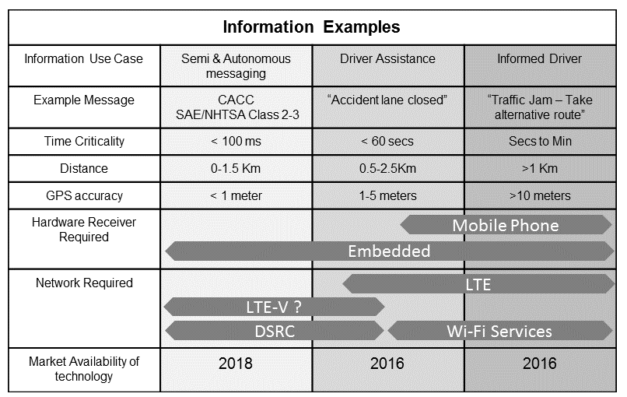
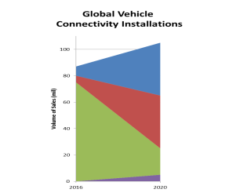
The Technology Mix
Embedded Modem Receivers
Data received directly into car
Smartphone Graphic
and Audio transfer
Smartphone Audio Transfer
Safety & Autonomous V2X Communications
The method of communication to and from vehicles is dependent upon the installed technology
The content of the communication depends on BOTH the installed technology BUT also the information type and urgency
Connected Corridors must take into account installed technology, information type and urgency to provide near-term benefits and long-term solutions

Slide 5
Challenges and Successes
Challenges
Large consortium – complex WP interactions - takes time to agree direction
Infrastructure power constraints
Ensuring project continues to be aligned with changes to protocol, standards and technology during the project life – how to keep the research up to date and relevant – funding required scope changes
File sharing
Successes
USE CASES defined
Vehicle architecture frozen
High level architecture defined
Infrastructure design completed
Bench testing complete
Prototype android app complete (virtual gantry)
Cyber Security SoA report issued
1st UK LTE-V vehicle demo for CACC
High visibility

Slide 6
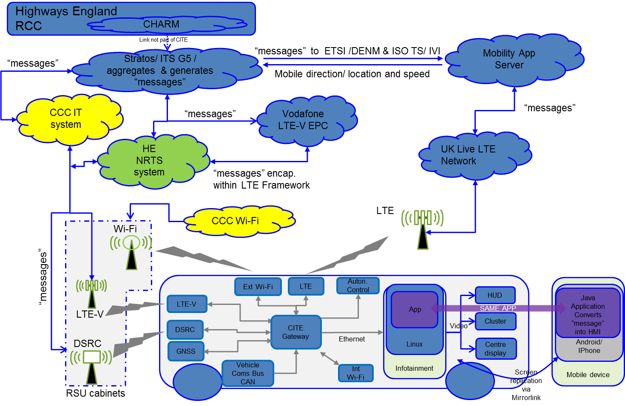
High Level System Architecture
RCC – Regional Control Centre, CCC – Coventry City Council, NRTS - National Road Telecommunication system, DSRC – Dedicated Short Range Communications

Slide 7
Test Route Road and Track
Five different road types
Smart Motorway (M42)
Motorway (M40)
Expressway(A46)
A-road (A45)
Urban (A4114/A4035)
Mixture of Urban and Interurban SRN
DSRC V2V (802.11p)
Cellular V2V (LTE-V)
Cellular & DSRC V2I
Cellular V2N
A45
M42
A4114
Solihull
Coventry
A4053
M42
J3A
A46
M40
M40
A46
Royal Leamington Spa
DSRC only sites
No V2X sites
Existing LTE (M42 coverage indicated only)
JLR (Gaydon)
Co-sited DSRC and LTE-V

Slide 8
Vehicles
100+ vehicles
Stage 1 - 3 fully kitted vehicles – OBU’s, embedded displays
Stage 2 – 20 vehicles per month for 5 months with mobile apps
Stage 3 – 20-30 vehicles with data connection via OBDII port

Slide 9
USE CASES

Slide 10
Timing
Project Start June 1st 2016
Bench Testing Q1 2017
Track Testing Q1-3 2017
Infrastructure Install Start May 2017
Road Testing From end Q2 2017
Infrastructure Completion April 2018
Project Finish Q4 2018

Slide 11
Key Next Steps
Complete process for enabling access to test bed by third parties (track and road)
Investigate further funding to a) close power gaps b) introduce LTE-V to the public road test bed

Slide 12
Thank You

